Slide 1


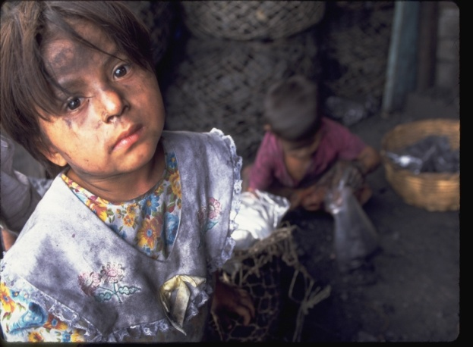
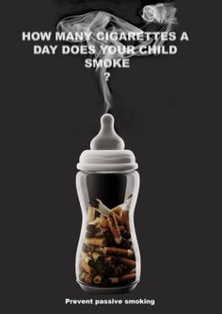
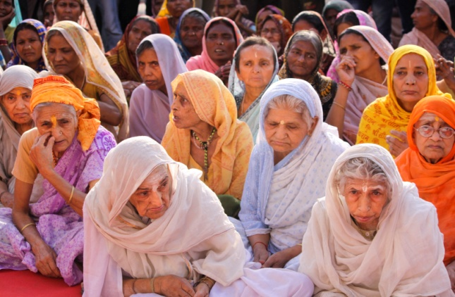
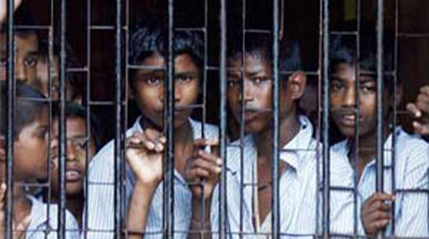
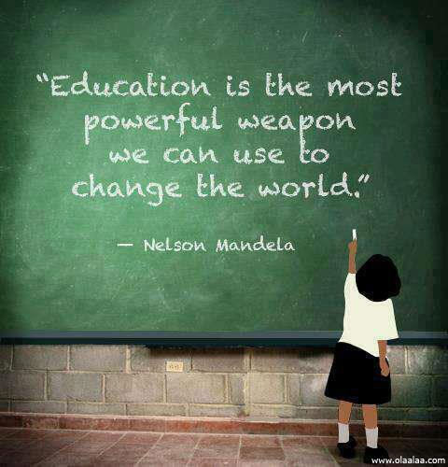
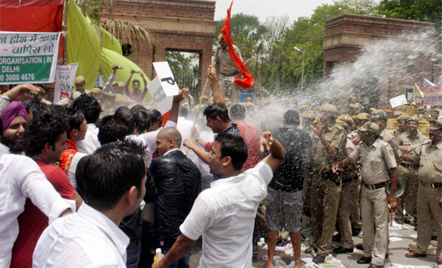
Social Issues

Slide 2

Gender Issue
Patriarchal society - Men hold authority over female family members and inherit family property and title
Son preference - Higher economic utility, Religious practices and Funeral rights
Discrimination Against girls - Medical treatment of illnesses, Nutritional discrimination
Dowry - Girls are a burden on families, Dowry Prohibition Act 1961, 498a of the Indian Penal Code (IPC)
Sex-Selective Abortion - Pre-conception and Pre-natal Diagnostics Technique Act in 1994(Sex Ratio 0-6 Years Age – 914/1000)
Literacy - literacy rate of females is 65.46%.
Gender-based violence – Rape ( National Crime Records Bureau 2013 annual report), Marital rape, Rape of minors, Honor Killing. Mathura Rape Case .

Slide 3
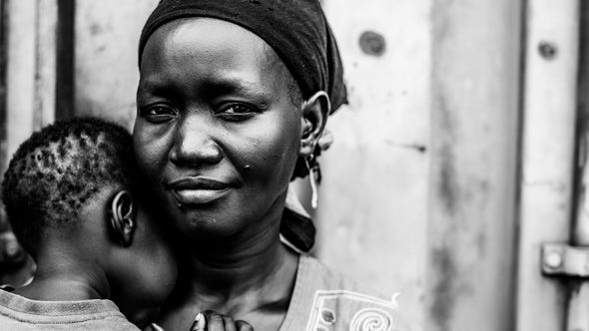
Ideological Framework
Maturity of Civilization
Atrocities – Dalit Women, Widows and NRI Husband
Child Prostitution, Human Trafficking
Social Stigma – Self Justification
Moral Policing – Mangalore Pub
Ethics and Morality
Caste Conflict
Consumerist Lifestyle

Slide 4
India’s Solution
Year | Act
1956 | Immoral Traffic
1961 | Dowry Prohibition
1987 | Sati
1990 | National Commission For Women
2000 | Juvenile Justice
2005 | Domestic Violence
2006 | Child Marriage
2009 | Right to education act
2012 | Protection of children from sexual offenses.bill passed in both houses. brief summary given on prsindia.org

Slide 5
Schemes -Women and Girls
Beti bachao, Beti padhao" and "Sukanya Samriddhi account“
Beijing platform for action - Fourth World Conference on Women held in Beijing in ’95
CEDAW- Convention on the elimination of discrimination against women by UN
Central social welfare board under Ministry of Women and child Development
Ujjawala - Includes Rescue, Rehabilitation, Re-Integration and Repatriation for the victims
Justice Usha Mehra Committee - identify lapses on the part of public authorities and suggest measures to improve the safety and security of women in the capital
Justice JS Verma - to review existing laws and examine levels of punishment in cases of aggravated sexual assault and it has submitted its recommendations
Gender Budgeting – Since 2005

Slide 6
Specific Problem
Prostitution
 | Prostitution in India: Disturbing numbers
7 lakh | “Registered” sex workers in India (Health ministry, 2012)
40% | Of them are underage (Study by Women and child ministry)
33% | Of missing children never found. Many of them sold off as within India or in Middle-east.
Women in Prison
4 per cent of prison population is female
Problems: overcrowding, prolonged detention of under trial individuals, poor living conditions, and allegations of physical, sexual and mental abuse
need for a comprehensive revision of the prison laws.
Trans Gender
A separate column in all Government and non-Government records to include the third gender.
Ministry of Social Justice and Empowerment along with the Ministry of Statistics and Programme Implementation will determine the number of transgendered persons in India and their socio-economic status.
then a new law will be created to protect interests of the community +education, housing, access to healthcare, skill development, employment opportunities and financial assistance.

Slide 7
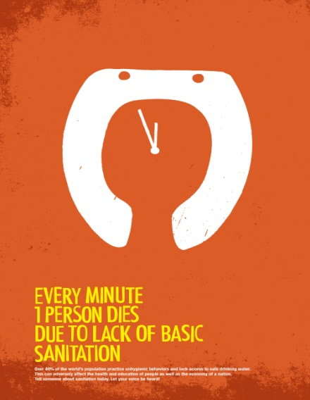
SANITATION
Fifty five percent of this population (nearly 600 million people) has no access to toilets , made up by people who live in urban slums and rural areas .
List of diseases caused by lack of sanitation - Stunted growth, Cholera and Diarrhoea “Building toilets is a priority over temples”
Nearly 1.9 million Indians accounting for one-fifth of the global TB cases
Estimated 72% of Indians still lack access to improved sanitation facilities.
More than 72% of rural people relieve themselves behind bushes, 1 billion people in the world who have no toilet, India accounts for nearly 600m
Infant Mortality Rate (IMR) - death of infant before 1st birthday per 1000 live births
Rural (46), Urban (28) , 12th FYP target: 25

Slide 8
Government Initiatives
Article 47 (Part IV: directive principles of state policy)-State shall regard the raising of the level of nutrition and the standard of living of its people and the improvement of public health as among its primary duties.
The Government of India launched the Total Sanitation Campaign (TSC) in 1999 with the goal of achieving universal rural sanitation coverage by 2012, the government introduced an innovative incentive programme known as Nirmal Gram Puraskar (NGP) in 2003
Provide toilets with water in all schools and Anganwadi centres
Active involvement of women in determining the location of sanitation facilities.
Difficulties in the usage of toilets will be addressed (eg. need for lighting, inappropriate location, and so on)
Eco-sanitation, Non-flushing, Self-composting toilets

Slide 9
Juvenile Delinquency
Family Factors – Parenting Style
Delinquent Peer Groups
Socio – Economic Status
Modelling
Labelling
Juveniles account for only about 16 percent of serious violent crimes, but nearly one-third (32%) of property crimes.
Ranjan Nayak a 16 year old lad from Khoir Mani, Baripada
Sunil Tudu a 17 year old boy from Rairang Pur, Mayurbhanj
Dibya Nayak (name changed), a 16 years old boy from Barbil near Bhola Garage, Keonjhar

Slide 10
Suggestions
More number of teachers should be appointed in the observation home so that it will be possible to provide teaching to the different age group of delinquents.
Developing the infrastructural facilities of Short stay homes and Observation homes is a top priority.
School drop outs should be handled properly to ensure that they are not becoming antisocial.
Proper counseling sessions at regular intervals is highly essential for these juveniles.
Delinquents should be dealt in a sensitive manner .Proper training should be given to the authority and caretakers in these homes.
Education should be an integral part of the positive development of these children in conflict with law.
Proper socialization from the childhood is a key requirement.
More parental focus towards their children is needed for their proper development.

Slide 11
Bachpan Bachao Andolan
An India-based movement campaigning for the rights of children, It was started in 1980 by Nobel Laureate Kailash Satyarthi
Focus has centred on ending bonded labour, child labour and human trafficking, as well as demanding the right to education for all children.
It has so far freed 80,000 children from servitude, including bonded labourers, and helped in their successful re-integration, rehabilitation and education

Slide 12
Education in India
Art - 21A Free and compulsory education for 6-14 y.o.a
Fundamental Duties - Develop scientific temper, humanism, spirit of inquiry and reform, Parent/guardian provide education to their 6-14 y.o.a
DPSP - State to look after Educational and economic interests of SC, ST,OBC.
Issues
Infrastructure-A study of 188 government-run primary schools found that 59% of the schools had no drinking water and 89% had no toilets
Curriculum issues-Modern education in India is often criticized for being based on rote learning rather than problem solving.
Awareness ,Affordability and Accessibility to Education

Slide 13
Scheme - food
Midday meal | Kids | Class 1 to 8. Applicable to Govt.schools, Government aided schools, local body schools, EGS, AIE centre , Madrasas and Maqtabs. Started in 1995.
SABLA | Girls | Rajiv Gandhi Scheme for Empowerment of Adolescent Girls To provide nutrition for growing adolescent girls by provision of food grains.(A kishori card )
Schemes: infra/Services
Sarva Shiksha Abhiyan (SSA) | Kids | Infra+services | Started in 2001. RTE is being implemented via SSA. alternative schools, Bridging gender-social gaps in enrolment, learning.
Sakshar Bharat | Illiterate adults. | Infra+service | Earlier known as National Literacy mission (NLM) For illeterates above 15+ age. Setup Lok Shiksha Kendras (Adult Education Centres). Primary focus is on Women.
Kasturba Balika Vidhyalaya | girls | Infra+service | Residential upper primary schools for girl SC,ST,OBC,Minority girlsTarget: scattered habitation.
ICT in schools | All | e-learning | High speed internet connection. Virtual classrooms, online teaching and other fancy stuff.

Slide 14
Poverty In India
Committees | Tendulkar | C.Rangarajan
Set up in | 2005 | 2012, May
Submitted report | 2009 | 2014, July
Poverty estimation method | Monthly per CAPITA Expenditure. | Monthly Expenditure of family of five.
Urban poverty line (Rs) | Tendulkar | C.Rangarajan
per day per person | 33 | 46.90=~47
per person per month | 1000* | 1407
per family of five, per month | 5000 | 7035
Rural poverty line (Rs) | Tendulkar | C.Rangarajan
per day per person | 27 | 32
per person per month | 816* | 972
per family of five, per month | 4080 | 4860*

Slide 15
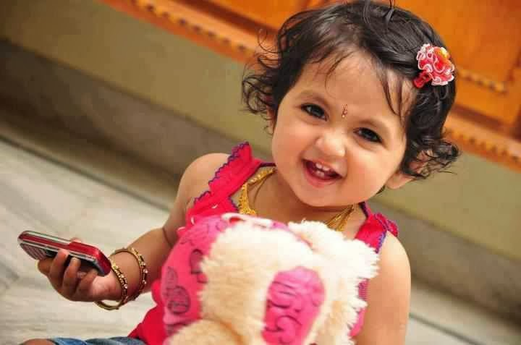
THANK YOU

Slide 16
Gender Issue

